Slide 1
Employee Turnover Prediction
ADMN5016
By Pimlapas Narongrit | Jettawat Vuttipakdee | Sadman Kabeer | Pooja Yadav

Slide 2
Reason for New Dataset & GitHub Links
A dataset on employee turnover would typically be chosen for predictive analysis to help a company understand the patterns and causes of employee departures. This understanding enables the development of effective retention strategies, aids in reducing the associated costs of turnover, and supports better human resource planning. By predicting which employees might leave, the company can take proactive measures to improve job satisfaction and employee engagement, potentially leading to a more stable and productive workforce.
 | GitHub link
Pimlapas Narongrit | https://github.com/LapasN/-LapasN-HR-Analytics---Employee-Turnover-Prediction/tree/main
Jettawat Vuttipakdee | https://github.com/JettawatV/HR-Analytics
Sadman Kabeer | https://github.com/Sadman1036/employees2
Pooja Yadav | https://github.com/Poojayadav98/AI-App

Slide 3
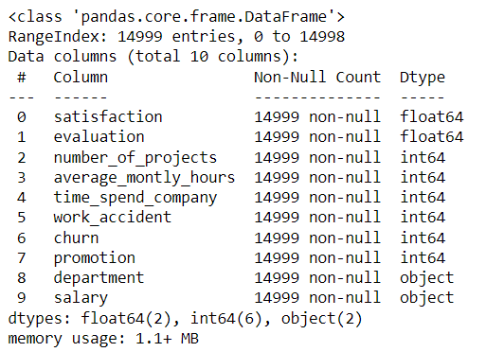
Checking info for each feature
Data Cleaning & Adjustment

Slide 4
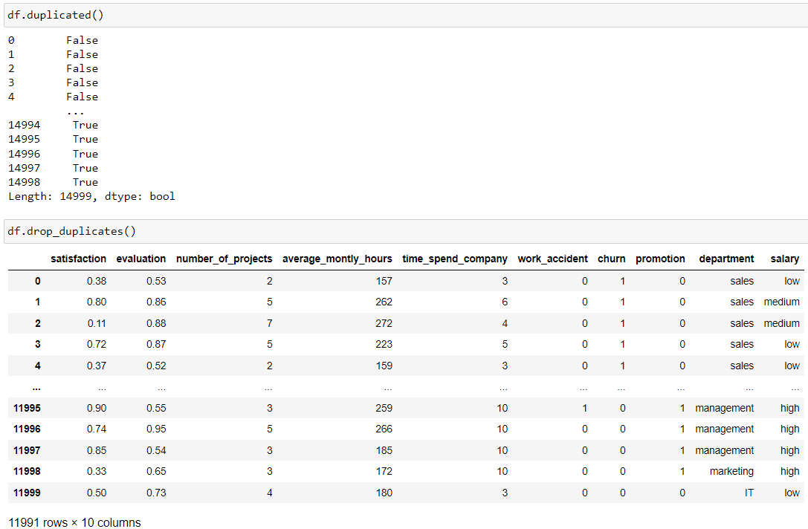
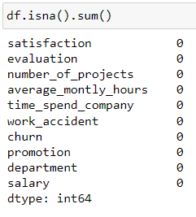
Handling Duplicates and Missing Values
Data Cleaning & Adjustment

Slide 5
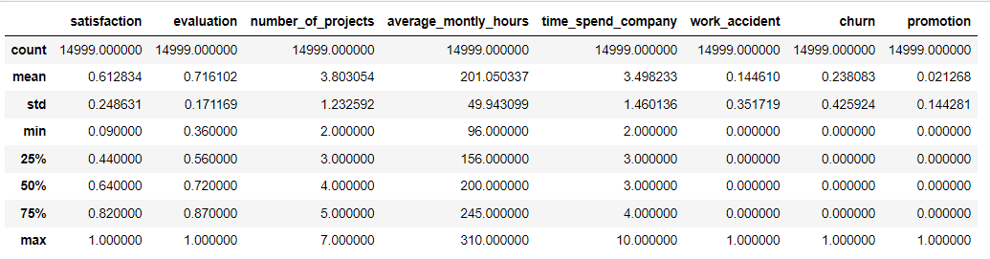
Statistical Summary
Exploratory Data Analysis
The dataset comprises 14,999 samples, each containing attributes related to employee characteristics and work-related factors. Key numerical attributes include satisfaction levels (mean ≈ 0.61), performance evaluations (mean ≈ 0.72), number of projects (mean ≈ 3.80), average monthly hours worked (mean ≈ 201.05), time spent with the company (mean ≈ 3.50 years), work accidents (mean ≈ 0.14), churn rate (mean ≈ 0.24), and promotions (mean ≈ 0.02). These metrics provide insights into employee engagement, workload, tenure, safety incidents, turnover, and career advancement within the dataset.

Slide 6
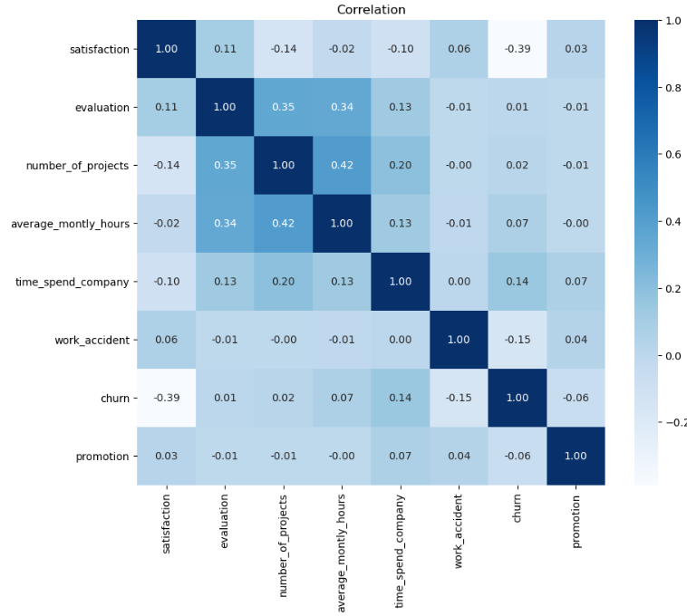
Correlation Heatmap
Exploratory Data Analysis
Satisfaction: Positively correlates with evaluation and negatively correlates with churn, implying that higher satisfaction relates to better evaluations and lower turnover rates.
Evaluation: Positively correlates with the number of projects and average monthly hours, suggesting that employees with higher evaluations tend to handle more projects and work longer hours.
Number of Projects: Positively correlates with average monthly hours, indicating that employees engaged in more projects tend to work more hours.
Average Monthly Hours: Positively correlates with time spent with the company, implying that longer-tenured employees work more hours on average.
Time Spent with Company: Positively correlates with churn, indicating that longer tenure correlates with higher turnover rates.
Work Accident and Promotion: Show no significant correlations with other attributes.

Slide 7
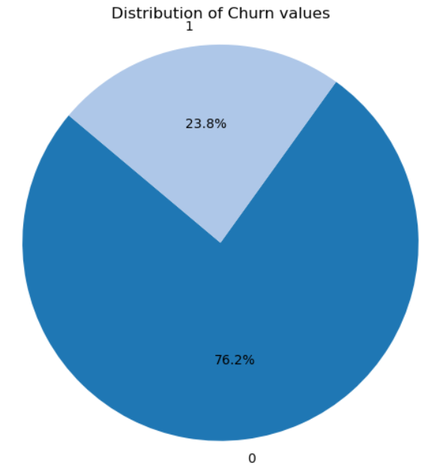
Distribution of Churn Values
Exploratory Data Analysis
Churn value 1 (indicating employee turnover) comprises approximately 23.8% of the dataset.
Churn value 0 (indicating employees who did not turnover) constitutes approximately 76.2% of the dataset.

Slide 8
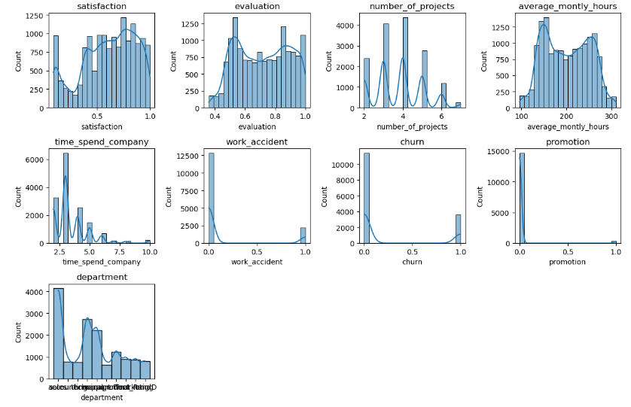
Shape of Data
Exploratory Data Analysis
The data is visualized using a grid layout, with each subplot representing the distribution of a specific feature.
Each histogram displays the distribution of values for the corresponding feature, with bins representing different value ranges.
Kernel Density Estimation (KDE) curves are overlaid on the histograms to provide a smooth estimate of the probability density function.
The title of each subplot corresponds to the name of the feature being visualized.
The plt.tight_layout() function ensures that the subplots are appropriately spaced within the figure.
The plt.show() function displays the generated visualization.

Slide 9
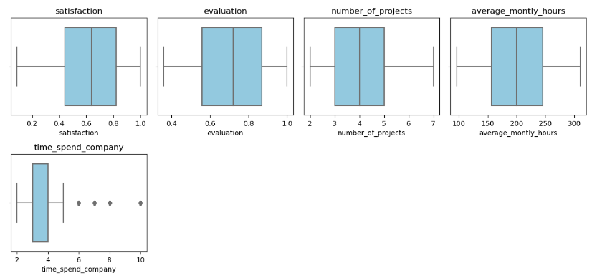
Box plot
Exploratory Data Analysis
The data is first scaled using the df_scale DataFrame, which includes only the selected features.
Boxplots are created for each feature, displaying the distribution of values and highlighting any potential outliers.
Each subplot represents a different feature, with the x-axis indicating the values of that feature.
Outliers, if present, are visualized as individual data points beyond the whiskers of the boxplot.
The title of each subplot corresponds to the name of the feature being visualized.
The plt.tight_layout() function ensures that the subplots are appropriately spaced within the figure.
Finally, the plt.show() function displays the generated visualization.

Slide 10
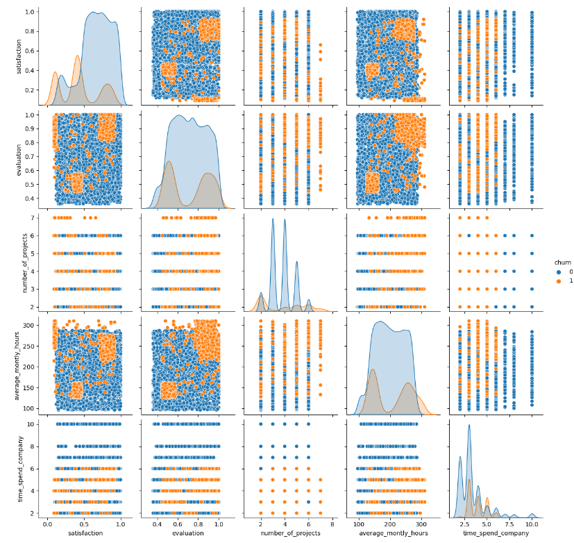
Relationship between Y and Xs
Exploratory Data Analysis
The independent variables (features) are stored in the variable 'X', excluding the target variable 'churn'.
The target variable 'churn' is stored in the variable 'y'.
The pairplot is created using the Seaborn library's pairplot function, which generates scatterplots for each pair of numerical features specified in the 'vars' parameter.
Each scatterplot is colored based on the target variable 'churn', allowing for the visualization of potential relationships between the features and the target.
The features included in the pairplot are 'satisfaction', 'evaluation', 'number_of_projects', 'average_montly_hours', and 'time_spend_company'.
The pairplot provides a visual overview of the relationships between these features and the target variable, which can help identify any patterns or trends in the data.
This visualization aids in understanding how each numerical feature relates to the target variable 'churn', facilitating exploratory data analysis and informing subsequent modeling decisions.

Slide 11
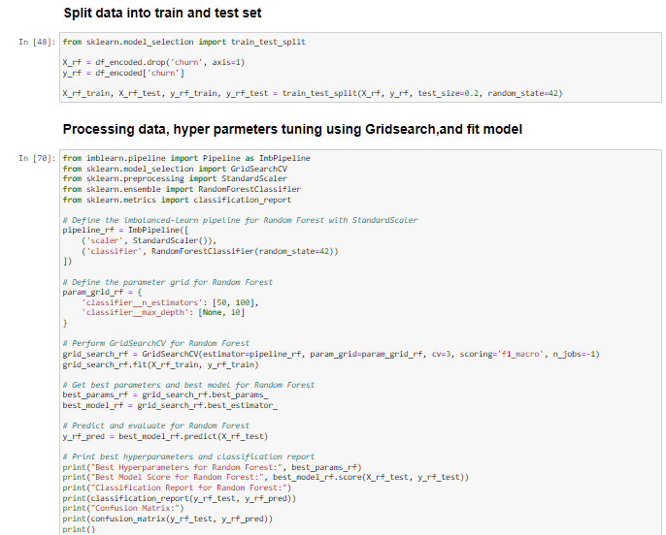
Random Forest Classifier
Model Development
Steps
Pipeline Definition: Create a pipeline for Random Forest classifier including feature scaling (StandardScaler) and the classifier itself (RandomForestClassifier).
Parameter Grid Definition: Define the grid of hyperparameters to search over during cross-validation, including the number of trees and the maximum depth of trees.
Grid Search Cross-Validation: Use GridSearchCV to find the best hyperparameters for the Random Forest model by searching over the defined parameter grid with cross-validation.
Evaluation: Retrieve the best hyperparameters and the best model from the grid search. Use the best model to predict the test data and evaluate its performance using a classification report and confusion matrix.

Slide 12
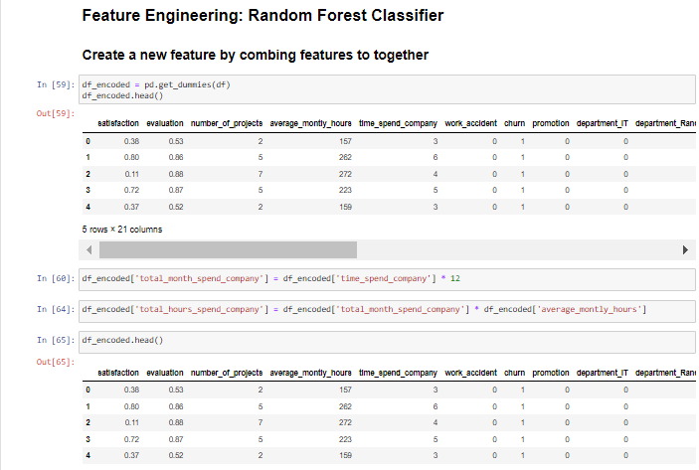
Random Forest Classifier with combined Feature
Model Development
Creating New Features
df_encoded['total_month_spend_company'] = df_encoded['time_spend_company'] * 12: This line creates a new feature called 'total_month_spend_company' by multiplying the 'time_spend_company' feature with 12. It essentially calculates the total number of months spent at the company.
df_encoded['total_hours_spend_company'] = df_encoded['total_month_spend_company'] * df_encoded['average_montly_hours']: This line creates another new feature called 'total_hours_spend_company' by multiplying the previously created
'total_month_spend_company' feature with the 'average_montly_hours' feature. It computes the total number of hours spent at the company, taking into account the average monthly hours worked.

Slide 13
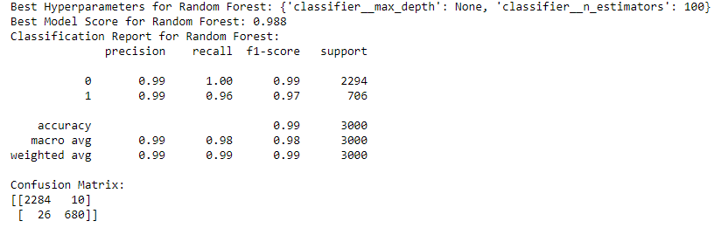
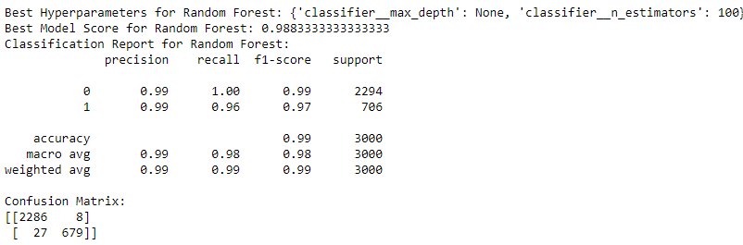
Random Forest Classifier Results
Exploratory Data Analysis
Random Forest
Model Comparison
Comparing the two sets of results, we observe very similar performance metrics between the models with original features and combined features. Both models achieved high accuracy, precision, recall, and F1-scores. The confusion matrices show minimal differences in the number of false positives and false negatives. Overall, the combined features did not significantly alter the model's performance, indicating that the additional feature did not substantially impact the predictive power of the Random Forest model.
Random Forest with combined feature

Slide 14
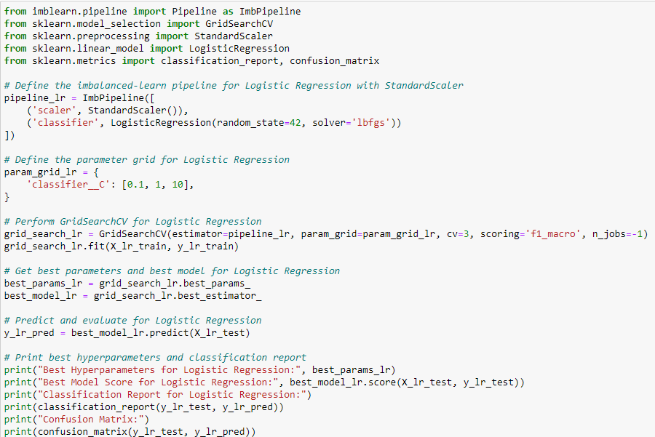
Logistic Regression
Model Development
Steps
Setup Pipeline: Create a pipeline (pipeline_lr) with a scaler (StandardScaler) and a logistic regression classifier (LogisticRegression).
Define Parameter Grid: Set up a parameter grid (param_grid_lr) for hyperparameter tuning, focusing on different values of C.
Hyperparameter Tuning: Use GridSearchCV to search for the best hyperparameters using the defined parameter grid. Fit the grid search object to the training data (X_lr_train, y_lr_train).
Select Best Model: Retrieve the best parameters (best_params_lr) and the best model (best_model_lr) found during the search.
Model Evaluation: Make predictions (y_lr_pred) using the best model on the test data (X_lr_test). Print the best hyperparameters and classification report, including metrics like accuracy, precision, recall, and F1-score. Print the confusion matrix to visualize the model's performance.

Slide 15
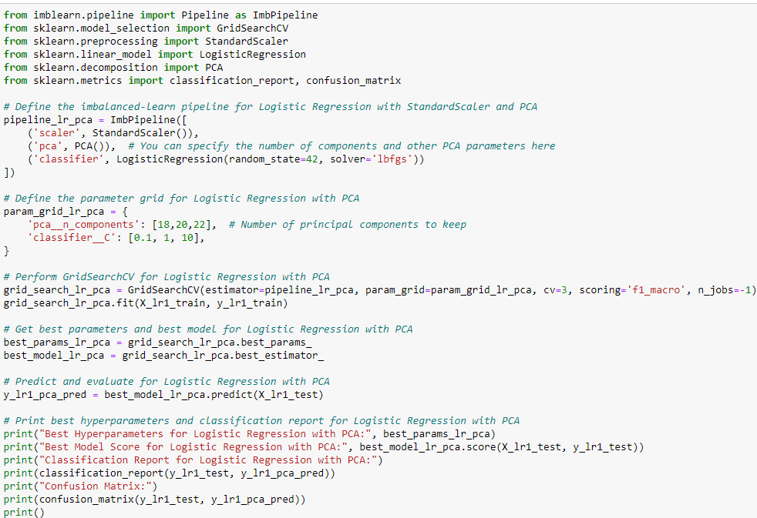
Logistic Regression with PCA
Model Development
Steps
Setup Pipeline: Create a pipeline (pipeline_lr_pca) with a scaler (StandardScaler), PCA (PCA), and a logistic regression classifier (LogisticRegression).
Define Parameter Grid: Set up a parameter grid (param_grid_lr_pca) for hyperparameter tuning, focusing on different values of n_components for PCA and C for logistic regression.
Hyperparameter Tuning: Use GridSearchCV to search for the best hyperparameters using the defined parameter grid. Fit the grid search object to the training data (X_lr1_train, y_lr1_train).
Select Best Model: Retrieve the best parameters (best_params_lr_pca) and the best model (best_model_lr_pca) found during the search.
Model Evaluation: Make predictions (y_lr1_pca_pred) using the best model on the test data (X_lr1_test). Print the best hyperparameters and classification report, including metrics like accuracy, precision, recall, and F1-score.
Print the confusion matrix to visualize the model's performance.

Slide 16
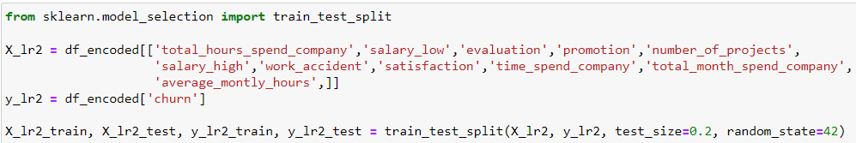
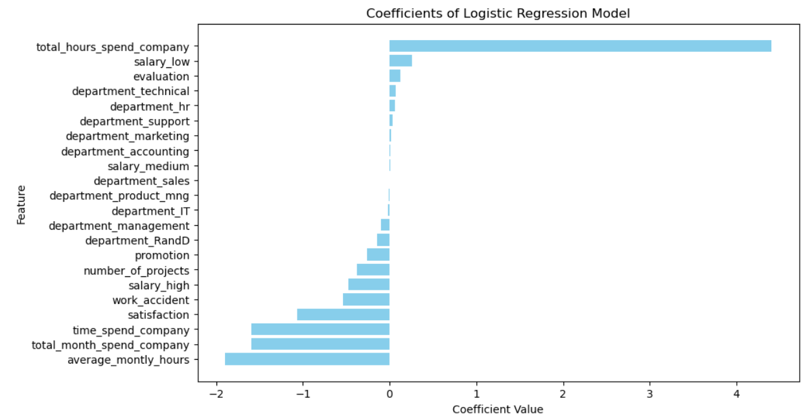
Logistic Regression with Selected Features
Model Development
Steps
Feature and Target Selection: Select the features (X_lr2) and the target variable (y_lr2) from the encoded DataFrame (df_encoded).
The selected features include various attributes such as total hours spent in the company, salary level, evaluation score, promotion status, number of projects, work accident occurrence, satisfaction level, time spent in the company, total months spent in the company, and average monthly hours.
Train-Test Split: Utilizes the train_test_split function from sklearn.model_selection to split the dataset into training and testing sets. The test_size parameter determines the proportion of the dataset to include in the test split. Here, it's set to 0.2, indicating that 20% of the data will be used for testing.
random_state ensures reproducibility by fixing the random seed for the split.

Slide 17
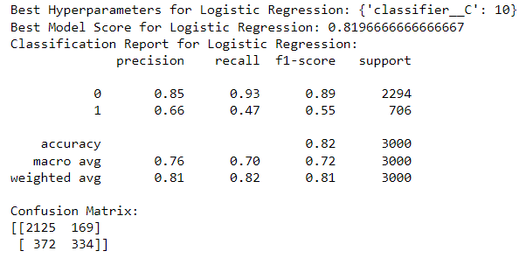
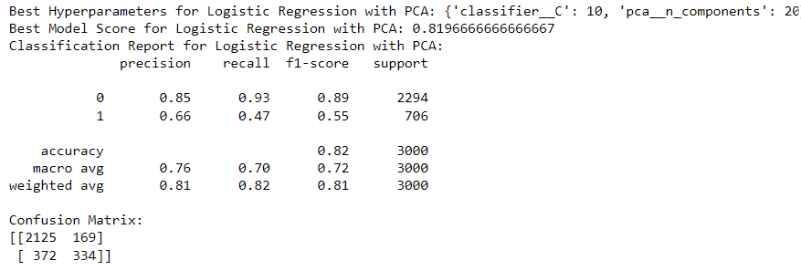
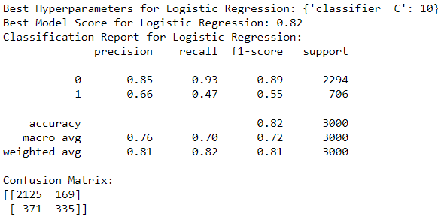
Logistic Regression Results
Results
Logistic Regression
Logistic Regression with PCA
Summary
All three logistic regression models perform similarly, with accuracies around 0.82.
They exhibit good precision, recall, and F1-score for class 0 (not churned), indicating a strong ability to predict non-churn instances.
However, they show relatively lower precision, recall, and F1-score for class 1 (churned), suggesting that the models struggle more with predicting churn instances accurately.
The addition of PCA or using selected features does not significantly impact model performance compared to using all original features.
Logistic Regression with Selected Feature

Slide 18
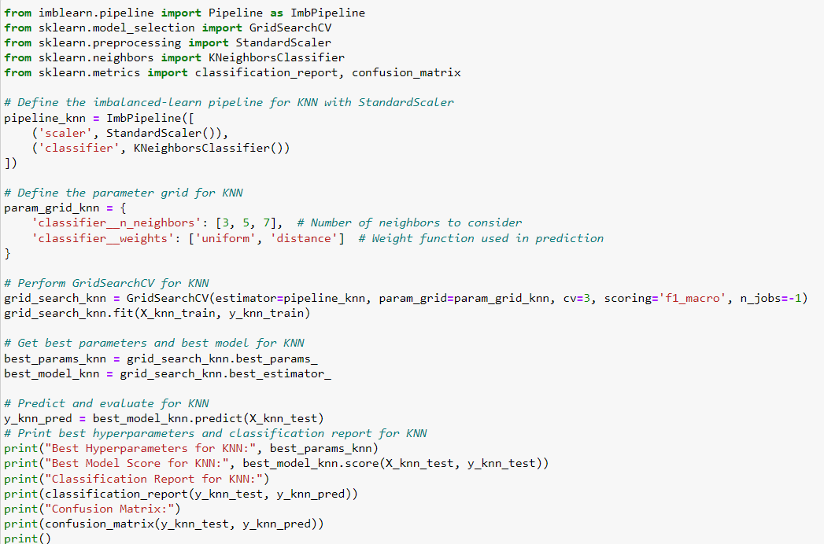
KNN Classifier
Model Development
Steps
Data Preparation and Split: The code starts with importing the necessary functions and splitting the dataset into features (X_knn) and target (y_knn) using the train_test_split function from sklearn.model_selection. It reserves 20% of the data for testing and sets a random state for reproducibility.
Pipeline and Hyperparameter Grid: An imbalanced-learn pipeline (ImbPipeline) is created, including StandardScaler for feature scaling and KNeighborsClassifier for the classification task. A parameter grid (param_grid_knn) is defined for tuning the KNN classifier's hyperparameters, such as the number of neighbors (n_neighbors) and the weight function used in prediction (weights).
Model Training and Prediction: The code performs hyperparameter optimization using GridSearchCV, which includes cross-validation (cv=3) and a scoring method focusing on the macro-average F1 score ('f1_macro'). After finding the best hyperparameters (best_params_knn) and the best KNN model (best_model_knn), predictions are made on the test set, although the code for evaluation (like the classification report and confusion matrix) isn't shown in the screenshot.

Slide 19
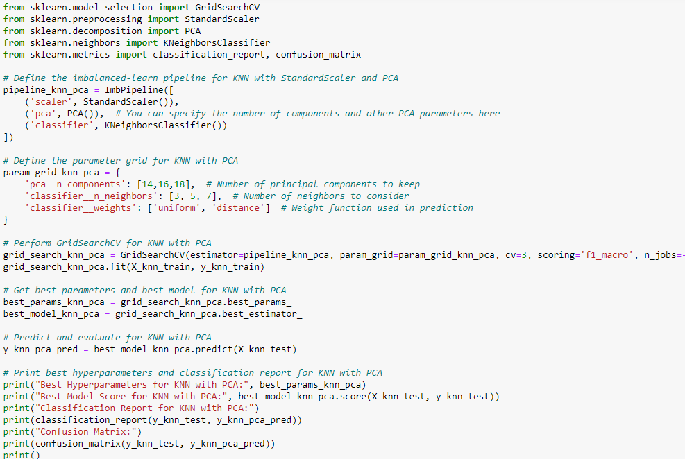
KNN Classifier (Feature Engineering)
Model Development
Steps
Pipeline Definition: The code initializes a machine learning pipeline (pipeline_knn_pca) consisting of three main steps: StandardScaler: For feature normalization. PCA: For dimensionality reduction. KNeighborsClassifier: The classification model.
Hyperparameter Grid Setup: It constructs a parameter grid (param_grid_knn_pca) that includes hyperparameters for both PCA and KNN. This expanded grid allows for tuning both sets of hyperparameters simultaneously.
Model Training and Evaluation: GridSearchCV is employed to search for the best combination of hyperparameters within the specified grid. This process involves cross-validation to evaluate model performance. The best hyperparameters (best_params_knn_pca) and the best estimator (best_model_knn_pca) are identified based on the results of the grid search.
Prediction and Evaluation on Test Set: The best model is then used to make predictions on the test set (X_knn_test). Various evaluation metrics are computed, including the best model's score, classification report, and confusion matrix, providing insights into the model's performance with PCA feature transformation applied..

Slide 20
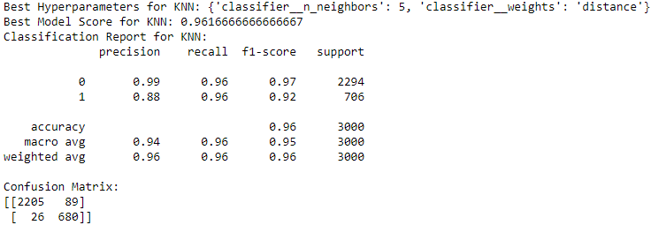
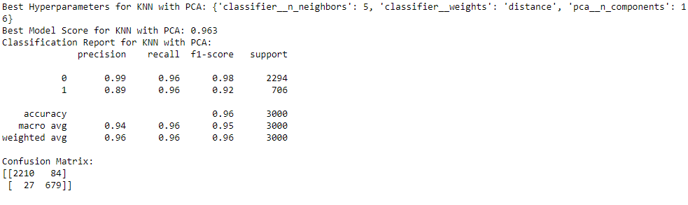
KNN Classifier Result
Results
KNN Classifier
Summary
Both KNN models, with and without PCA, demonstrate high accuracy and performance:
KNN without PCA:
Accuracy: 96.17%
Precision, recall, and F1-score for both classes are high.
Some misclassifications observed in the confusion matrix.
KNN with PCA:
Accuracy: 96.30%
Similar performance to KNN without PCA.
Slightly improved confusion matrix results, indicating fewer misclassifications.
In summary, both models perform well, but KNN with PCA shows a slight improvement in accuracy and confusion matrix results compared to KNN without PCA.
KNN Classifier with PCA

Slide 21
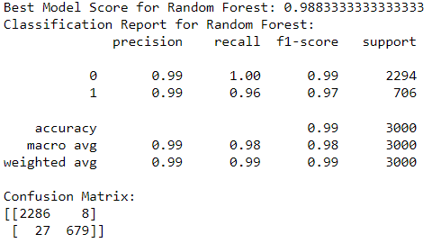
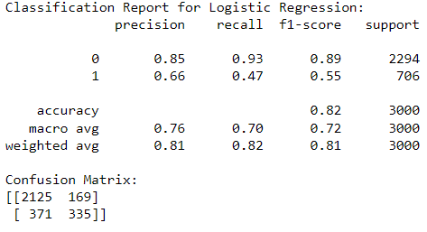
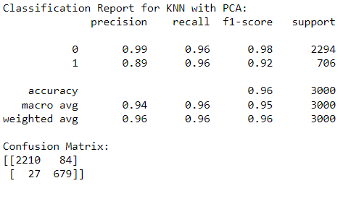
Result Summary for models
Results
Random Forest Classifier
Logistic Regression
KNN Classifier
Model Results Summary
Random Forest and KNN with PCA demonstrate superior performance compared to Logistic Regression.
Random Forest achieves the highest accuracy and exhibits excellent precision, recall, and F1-score for both classes.
KNN with PCA also performs exceptionally well with high accuracy and precision-recall-f1 scores.
Logistic Regression, while having a moderate accuracy, struggles more with predicting churn instances accurately, as indicated by its lower precision, recall, and F1-score for class 1.

Slide 22
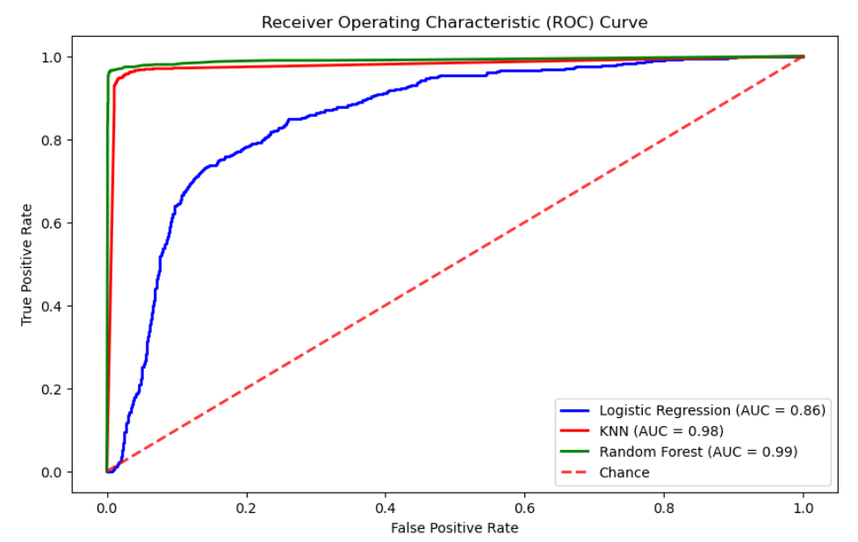
Receiver Operating Characteristics Curve
Results
Comparison of Model Performance: The ROC curve shows the performance of three different classification models - Logistic Regression, K-Nearest Neighbors (KNN), and Random Forest - by plotting the True Positive Rate (sensitivity) against the False Positive Rate (1 - specificity) at various threshold settings. The Area Under the Curve (AUC) scores are also provided for each model, with Logistic Regression having an AUC of 0.86, KNN having an AUC of 0.98, and Random Forest having an AUC of 0.99. The closer the AUC score is to 1, the better the model is at distinguishing between the positive and negative classes. The Random Forest model shows the best performance among the three, closely followed by the KNN model.
Significant Discriminative Ability: The fact that all models have AUC scores significantly higher than 0.5, which represents the diagonal 'Chance' line, indicates that each model has a good discriminative ability to distinguish between the positive and negative classes. The Random Forest and KNN models, in particular, are performing exceptionally well, with AUC scores very close to 1, suggesting that these models have excellent classification capabilities for this particular task.

